Slide 1
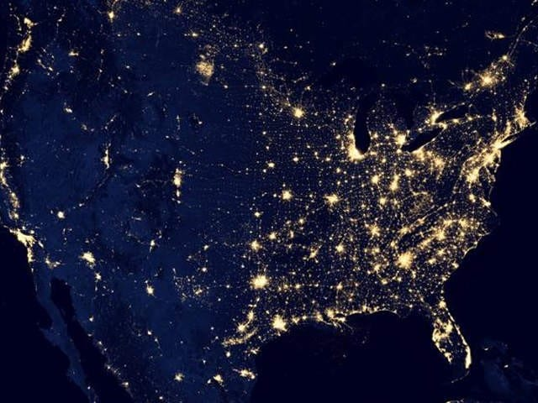
Introduction to SCENICS: Stereoscopy of Multi-scale Chemical Exchanges and Interactions between a City and its Surroundings
SCENICS-HAMAQ Partnership over Atlanta
August 2025
SCENICS Advisory, Leadership, and Collaborator Teams
NSF NCAR, Baylor, Florida State University, Georgia Tech, Savannah River National Laboratory, University of Alabama in Huntsville, University of Georgia, University of Oklahoma, Stony Brook, Georgia DEQ

Slide 2
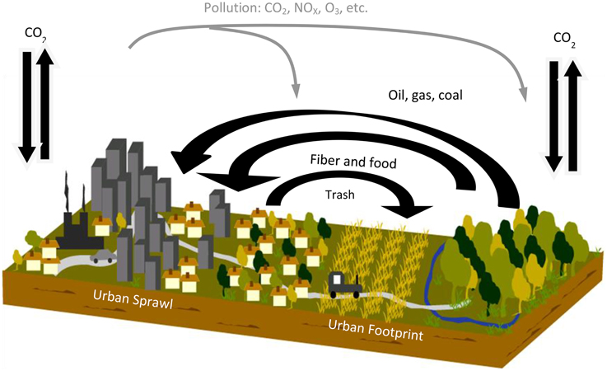

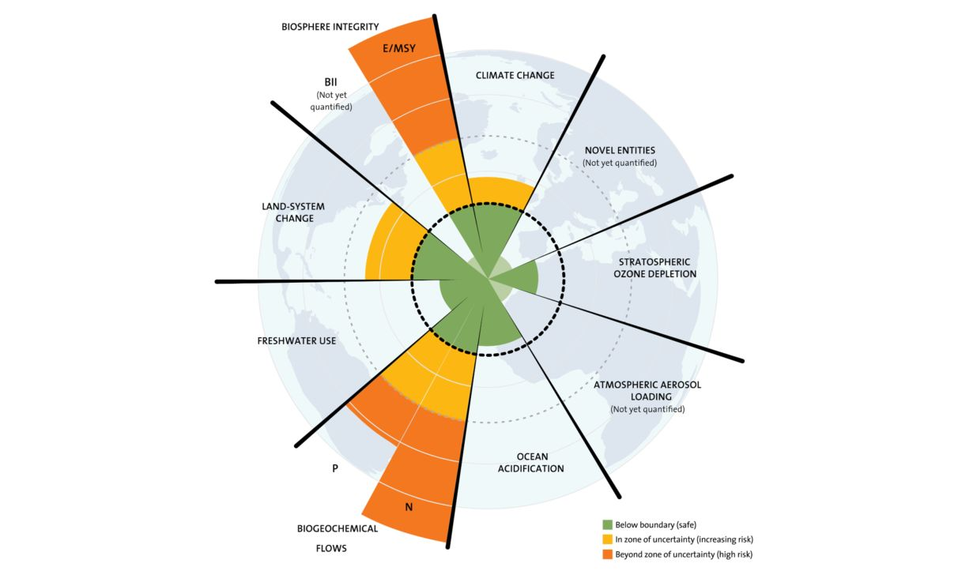
Goal
To enable predictability of coupled chemical and meteorological processes at street-level resolution, through an integrated measurement and modeling study of anthropogenic and biogenic emissions and boundary-layer fine-scale dynamics in an urban setting.
Interplay between urban emissions, chemical processing, boundary layer dynamics → economic prosperity, human health, and well-being
Coupled chemical and meteorological processes in urban archipelago → improved safety and national security
Influence of urban- and regional-scale form and land use on coupled Earth and urban system interactions

Slide 3
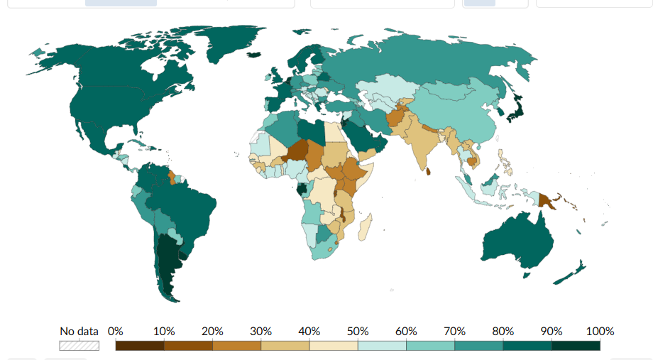
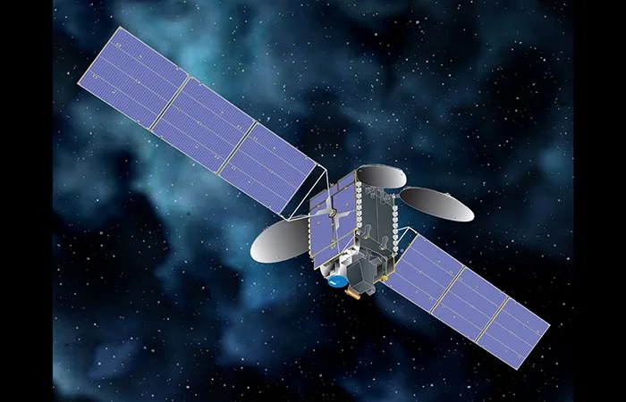
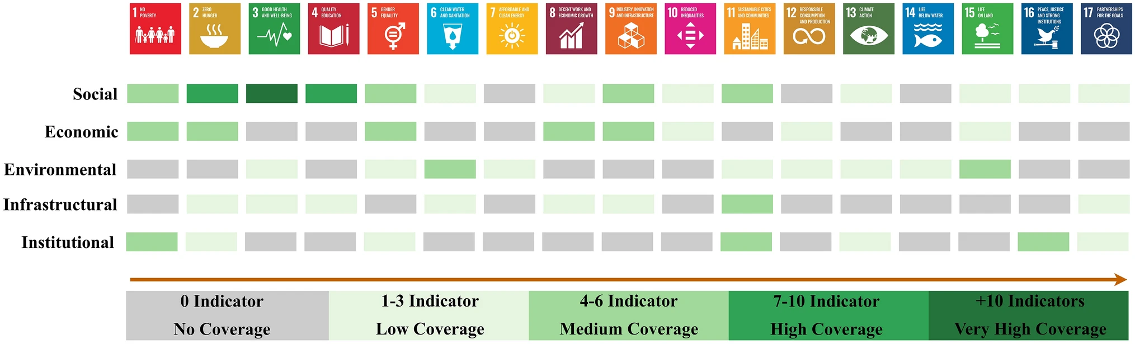
Motivation
urbanization:
now 30-80%
2050 >50%
1
1
urban-earth systems:
changes in the earth system undermine 16 of 17 UN sustainable development goals (Nerini et al., Nature, 2019)
2
2
expanding observational and modeling capabilities
3
3

Slide 4
Conceptual Approach
convergence
meteorology
stakeholders
integration
chemistry
2
2
education and outreach
3
3
society

Slide 5
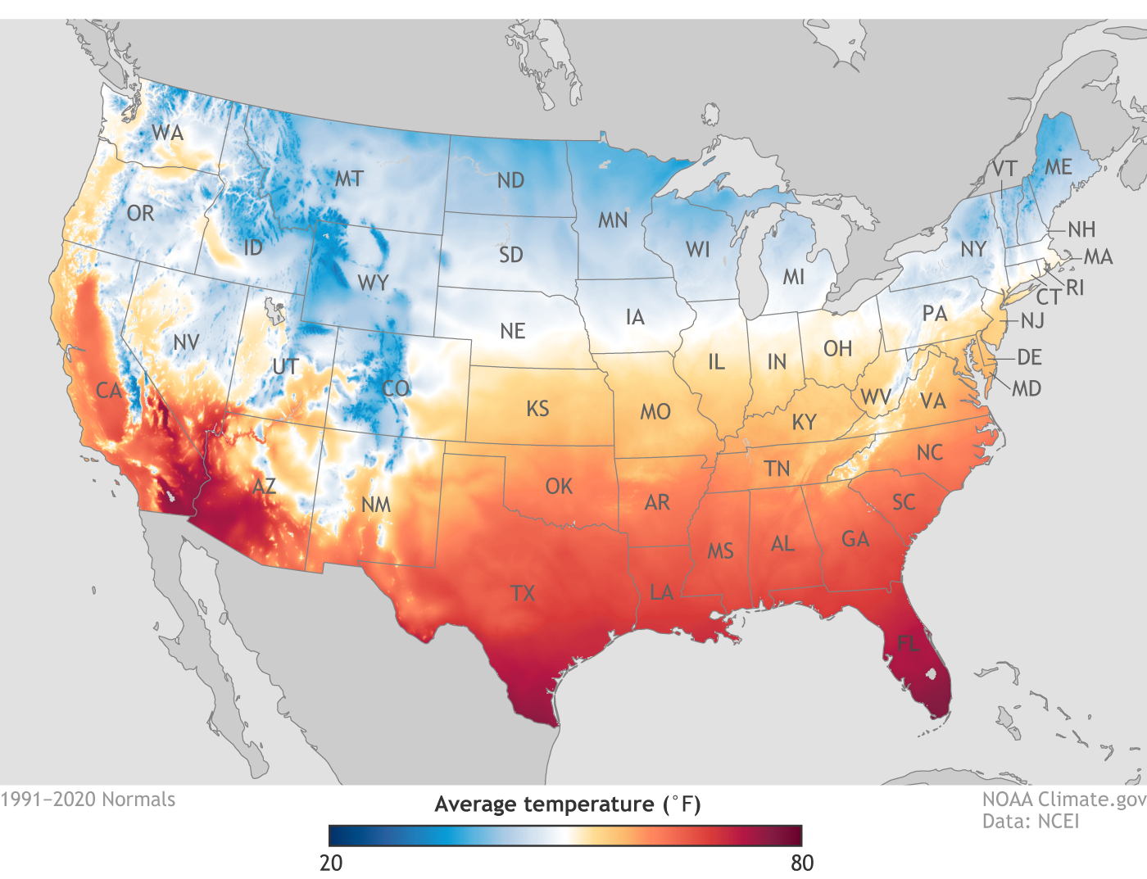
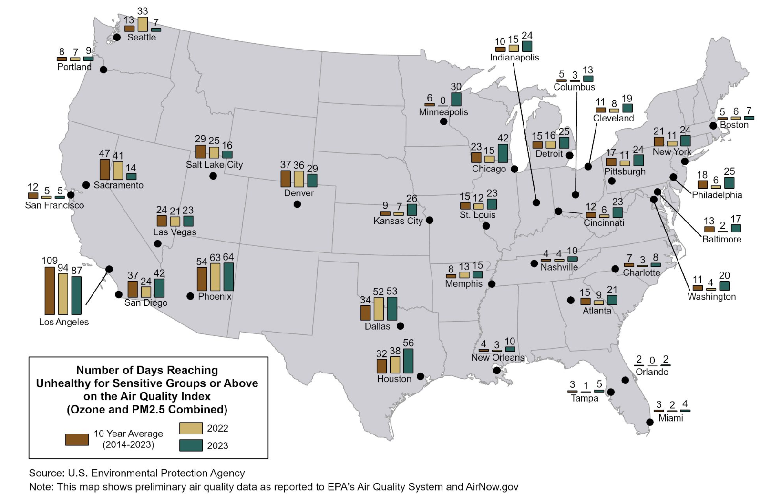
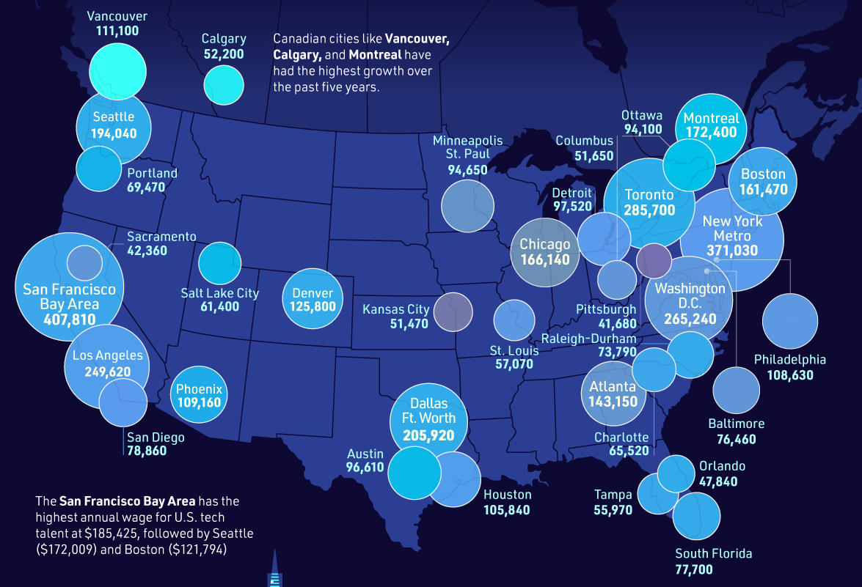
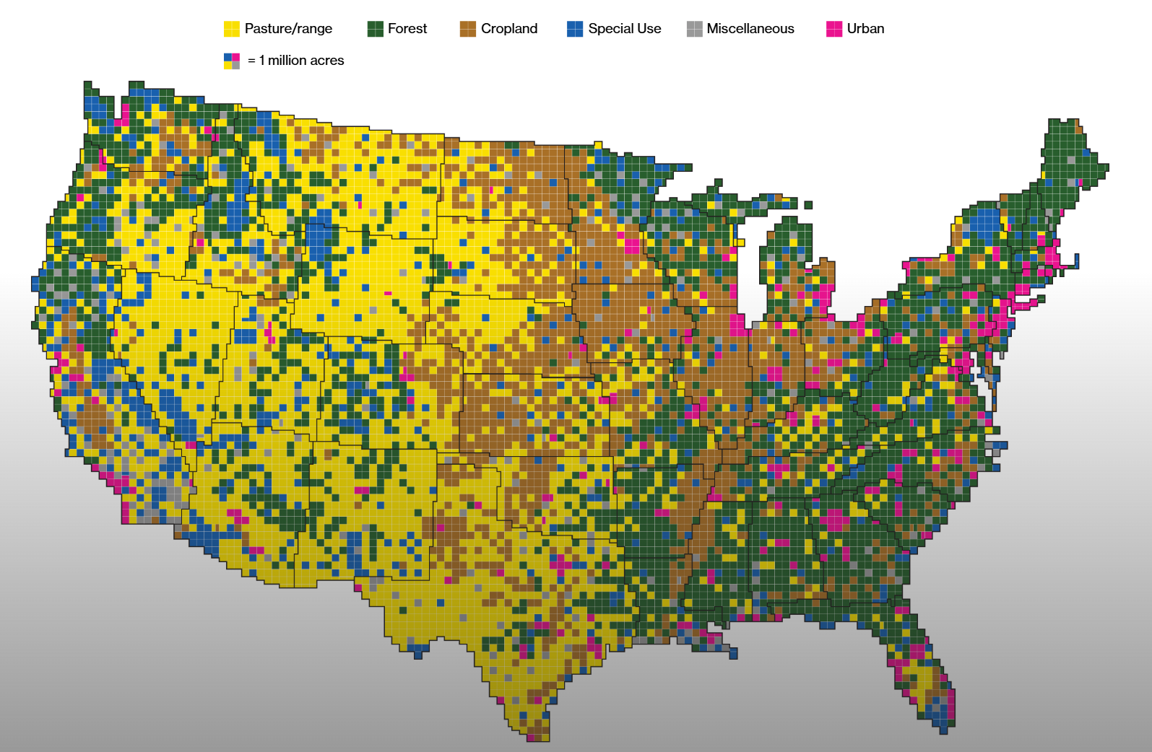

Prototype Urban Area: Atlanta
Heat
PM_{2.5} and Ozone
Tech Growth
Urban-Forest

Slide 6
Observational and Modeling Resources
Ground Observations (LOTOS nodes, towers, trailers, MAPNet, AERONET, Pandora, STN, ASCENT, Georgia EPD)
Models (hydrology, urban canopy, column, emissions, chemical transport, large eddy simulation, linear-regression-data fusion)
Airborne Observations (UAS, C130)

Slide 7
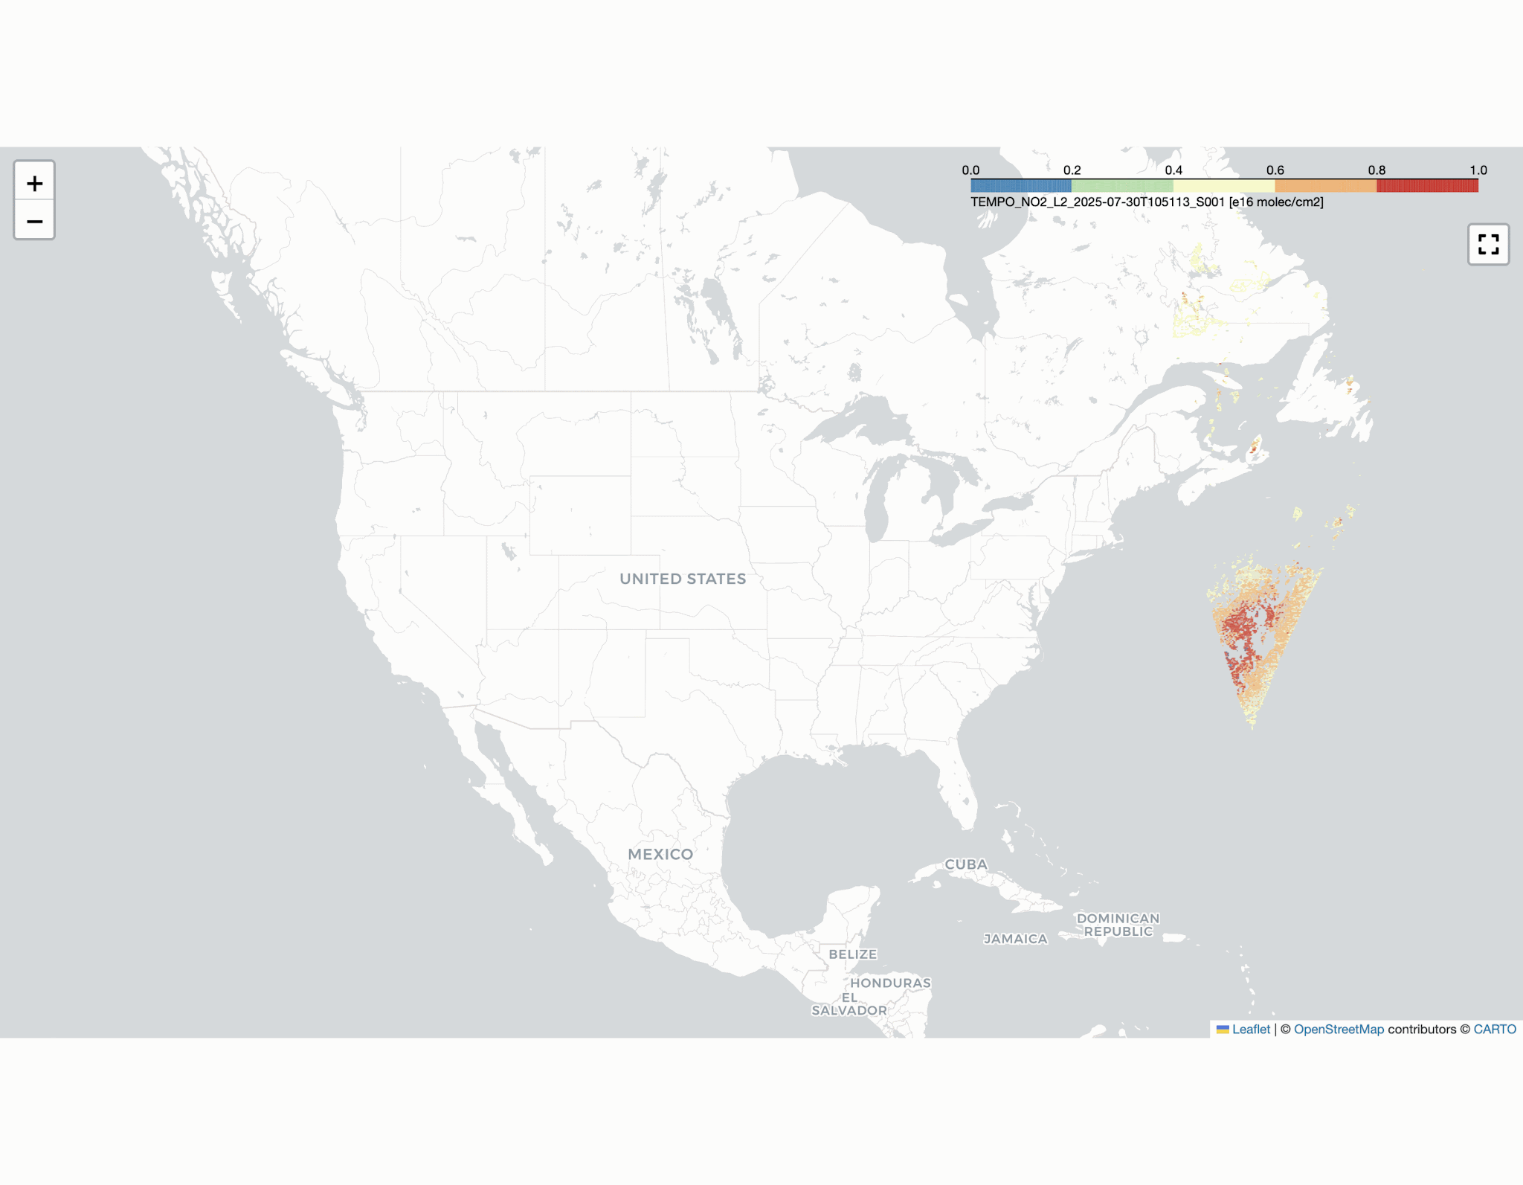
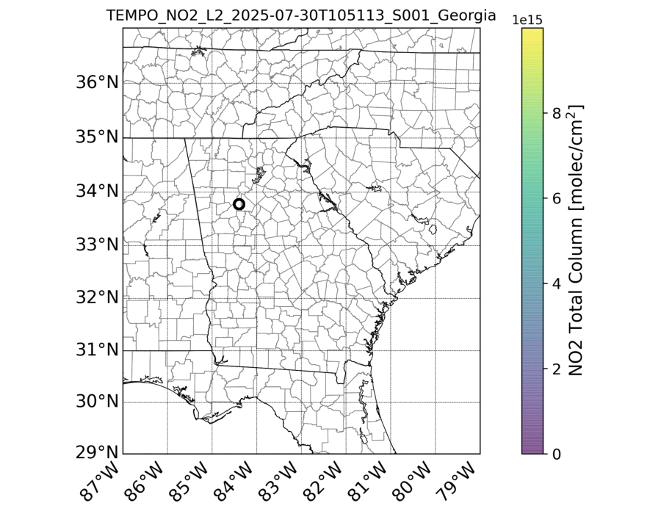
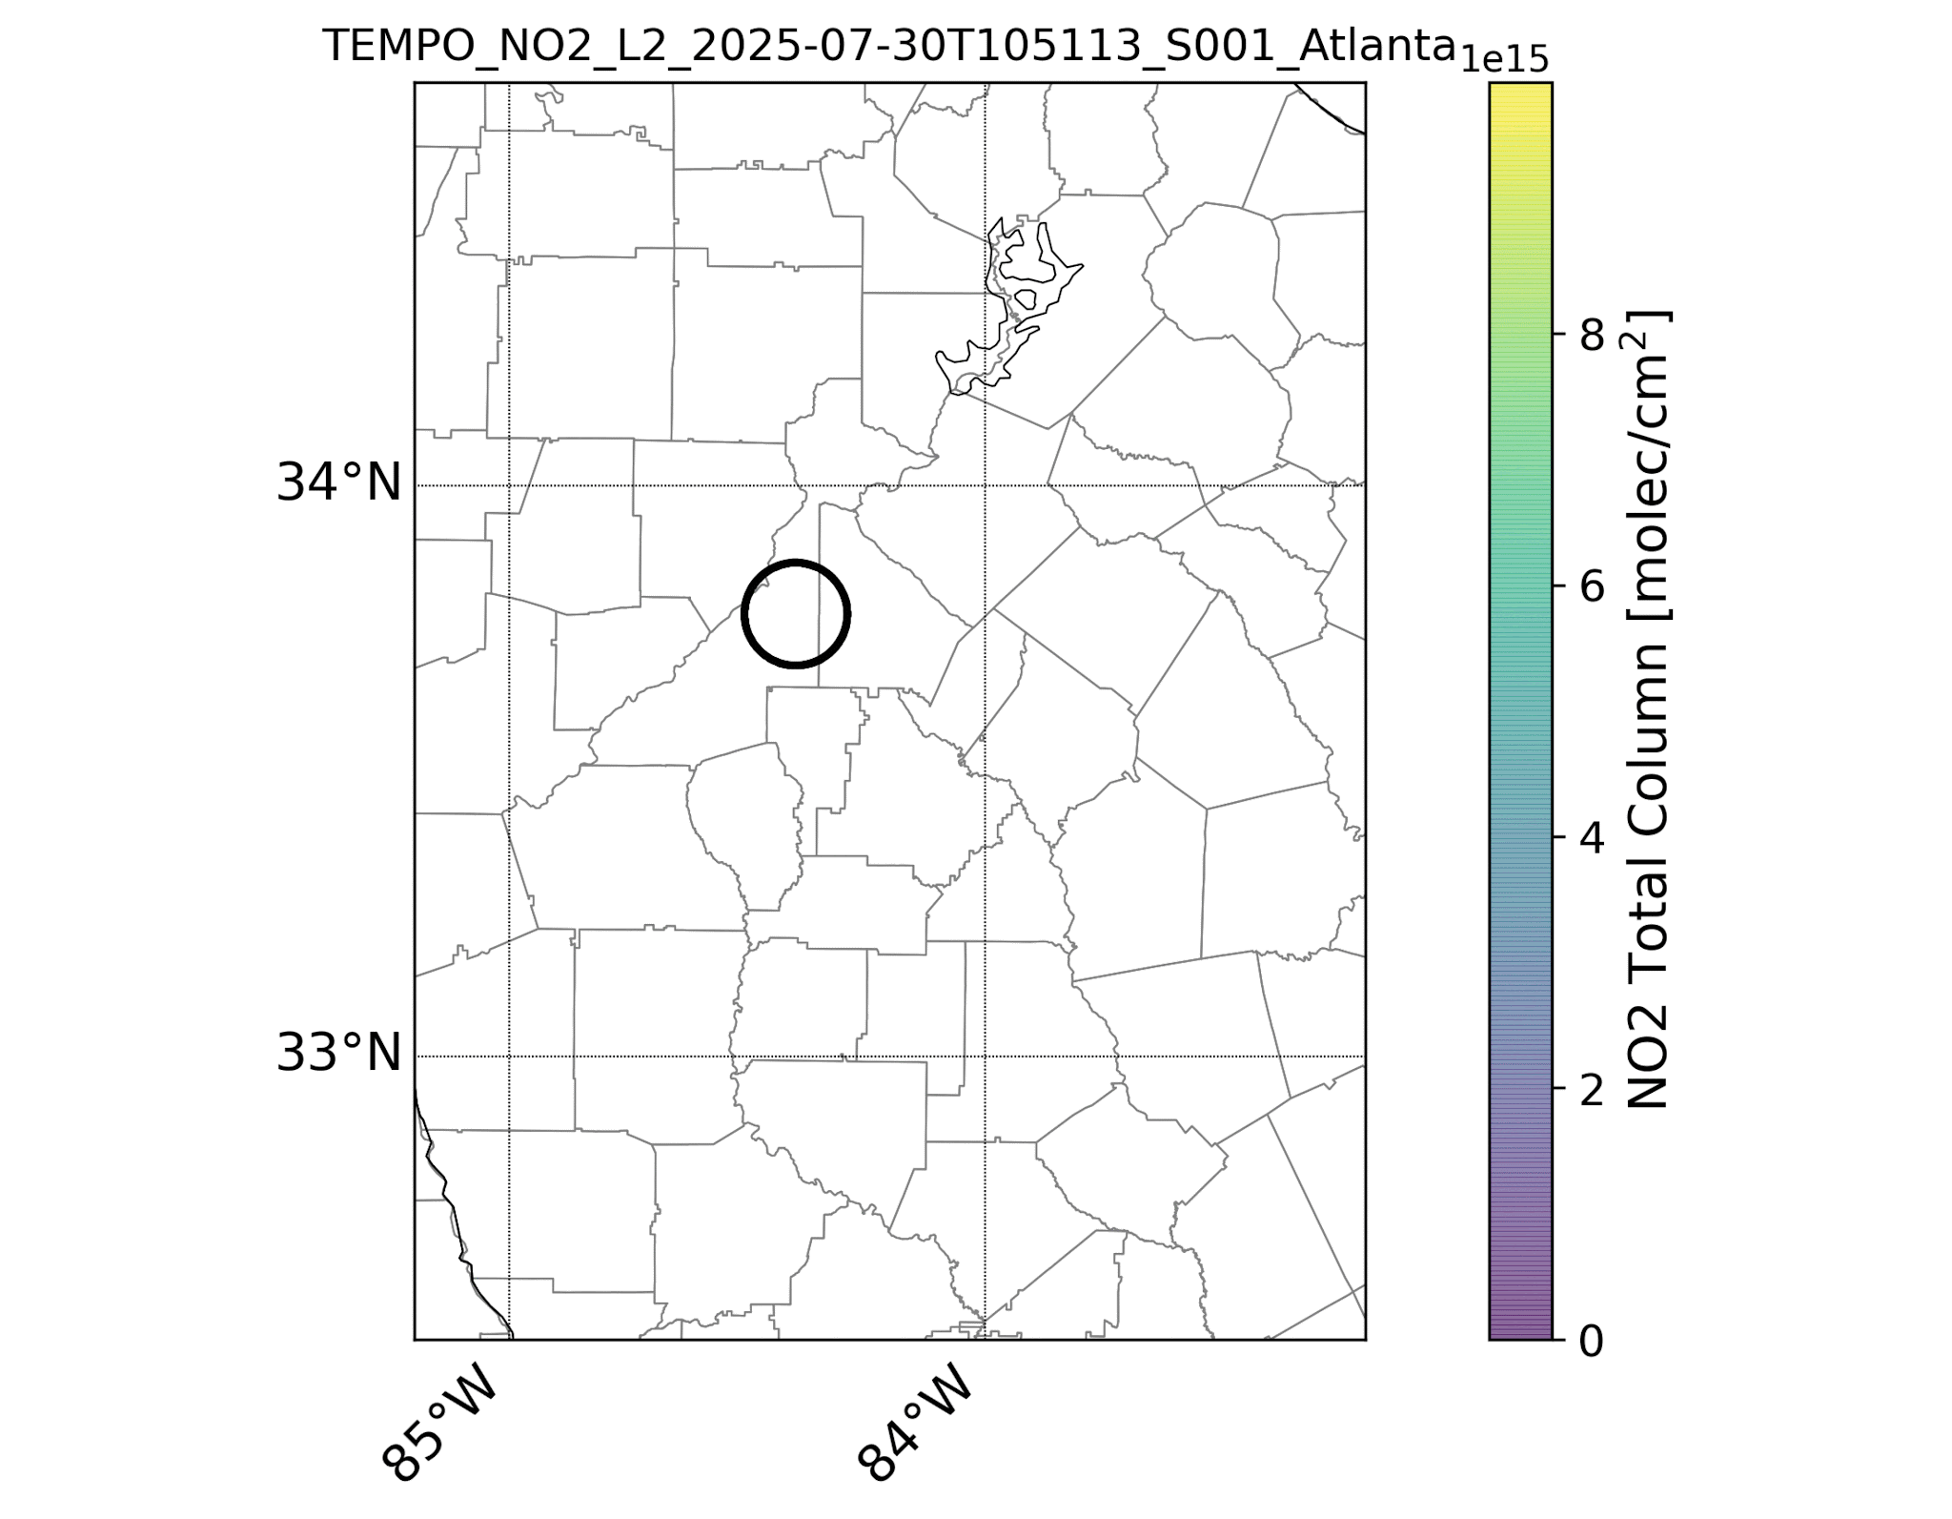
Groundwork: Remote Sensing of NO₂
Slide courtesy of Ivan Ortega (ACOM NCAR)

Slide 8
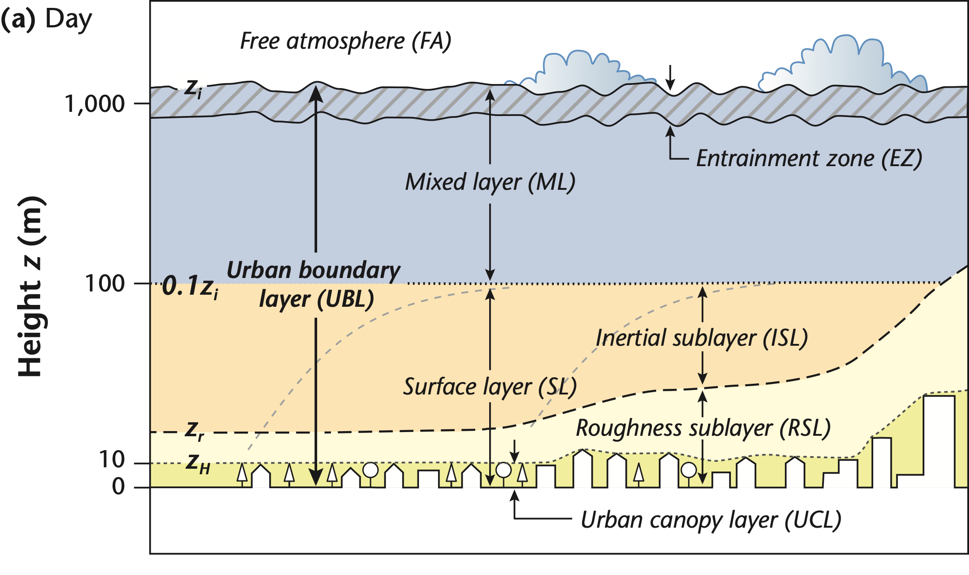




Groundwork: Coupled Chem-Met in the UBL
Scales of Observations
150 km – 15 km – 15 m - …
mean flow
Recirculation
Urban ABL Structure and Dynamics
Recirculation
Oke (2017)
+Scintillometer
+Scintillometer
+Scintillometer
+Scintillometer
LOTOS
Node #1
Rural
Upwind + CHEM
LOTOS
Node #2
Suburb
Upwind + CHEM
LOTOS
Node #3
(City Center) + CHEM
LOTOS
Node #4
Suburb
Downwind + CHEM
LOTOS
Node #5
Rural
Downwind
+ CHEM
Satellite PAMs
Satellite PAMs
Satellite PAMs
Satellite PAMs
Satellite PAMs
Satellite PAMs
Satellite PAMs
Satellite PAMs
Satellite PAMs
Satellite PAMs
Satellite PAMs
Surface-Based Observations
Satellite PAMs
+ street canyon / building scale sub-experiments
25 km
150 km
Slide courtesy of Sebastian Hoch (EOL NCAR)
assuming 5 LOTOS nodes

Slide 9
Complimentary Objectives
Satellite-surface network connections, chemically-detailed, vertically- and diurnally-resolved measurements
Magnitude and timing of emissions and sources
Satellite proxies for air quality
Factors controlling urban AQ
HAMAQ white paper
Meteorology
(see TEMPO-Informed Understanding of Urban Boundary Layer Dynamics in Atlanta, J. Wermter)
Integration
(see SCENICS: integration of Observations and Modeling in Atlanta for TEMPO and HAMAQ, G. Huang)
Chemistry
(see Atlanta for HAMAQ: Extending Chemical Analyses through SCENICS, J. Kaiser)

Slide 10
Science Questions
Leveraging TEMPO observations, fundamental….
What are the relative roles of multi-scale flow and chemical processing on the evolution of trace gases and aerosols inside the urban roughness sublayer?
What are the impacts of aerosols on urban-influenced convection and the feedbacks of in-cloud processes on aerosol formation during the warm season?
How do the diurnal co-evolution of the urban boundary layer and the chemical processing of emissions control chemical composition (vertically and horizontally) and transport into the surrounding rural regions?
Do higher temporal resolution column observations enable better constraints on emissions sources?

Slide 11
Science Questions
Leveraging TEMPO observations, applied….
How can urban planning (transportation, greening, etc.) be optimized to minimize heat and pollutant exposure in urban areas?
Can we use our measurements to train air quality models to provide accurate prediction of AQ episodes and neighborhood level exposure using routinely available remote sensing and in situ observations?
How do we best communicate information and choices around urban health risks (extreme weather, heat, pollution, etc.)?

Slide 12
SCENICS Structure
Advisory Team
urban meteorology measurements
Leadership Team
Collaborators
integration of observations, measurements-models, models across scales and foci
Contributors
revisit posters
stop us at anytime
ask us questions
air composition and chemistry measurements
stakeholder, educator, communication teams

Slide 13
Figure Sources
Slide 2:
10.3389/fcosc.2022.761449
https://earthzine.org/wp-content/uploads/2013/11/US-lights-at-night.jpg
https://www.pik-potsdam.de/en/news/latest-news/planetary-boundaries-interactions-in-the-earth-system-amplify-human-impacts
Slide 3:
https://ourworldindata.org/urbanization#all-charts
Slide 5:
https://www.climate.gov/news-features/featured-images/new-maps-annual-average-temperature-and-precipitation-us-climate
https://epa.maps.arcgis.com/apps/Cascade/index.html?appid=c22b170a699840ab96d19cc293c04951
https://www.bloomberg.com/graphics/2018-us-land-use/
https://www.visualcapitalist.com/biggest-tech-talent-hubs-in-us-canada/

